Slide 1
Machine Learning AI-414 (4 CrH = 2 Theory 2 Lab) Lecture No. 18 & 19
Mr. Saeed
Department of Computer Sciences
The University of Faisalabad (TUF)

Slide 2




www.tuf.edu.pk
unioffaisalabad
Today Agenda:
Expectation-Maximization (EM)
Define the Problem
Initialize the Model
Expectation Step (E-Step)
Maximization Step (M-Step)
Check for Convergence
Iterate Steps 3 and 4
Final Model

Slide 3
www.tuf.edu.pk
unioffaisalabad
Introduction
Semi-supervised learning (SSL) is a machine learning paradigm that combines labeled and unlabeled data to train models. Expectation-Maximization (EM) is a popular algorithm used in SSL to leverage the information from both types of data. In this approach, EM is used to estimate the model parameters by maximizing the likelihood of the complete data (labeled and unlabeled).

Slide 4
www.tuf.edu.pk
unioffaisalabad
Expectation-Maximization (EM)
Semi-supervised learning bridges the gap between supervised and unsupervised learning by utilizing both labeled and unlabeled data to train a model. Labeled data provides clear target outcomes, while unlabeled data offers abundant raw information. The Expectation-Maximization (EM) algorithm is a powerful approach for handling semi-supervised learning tasks, particularly for problems involving missing or uncertain labels.

Slide 5
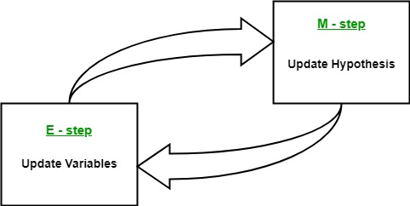
www.tuf.edu.pk
unioffaisalabad

Slide 6
www.tuf.edu.pk
unioffaisalabad
How EM Works in Semi-Supervised Learning
The EM algorithm is an iterative optimization process that alternates between assigning probabilities to the unlabeled data (Expectation Step) and updating the model parameters (Maximization Step) to better fit both labeled and pseudo-labeled data. This process continues until convergence.

Slide 7
www.tuf.edu.pk
unioffaisalabad
Semi-Supervised Learning (SSL)
SSL addresses the scenario where:
Labeled data is scarce or expensive to obtain.
Unlabeled data is abundant and inexpensive.
Input
Labeled data: {(x1, y1), ..., (xn, yn)} (n labeled samples)
Unlabeled data: {xu1, ..., xum} (m unlabeled samples)
Model parameters: θ (initial estimate)

Slide 8
www.tuf.edu.pk
unioffaisalabad
Expectation-Maximization (EM) Algorithm
EM is an iterative algorithm used for maximum likelihood estimation in the presence of missing or incomplete data.
Key Components
Expectation (E-Step): Calculate the expected value of the log-likelihood of the complete data given the observed data and current model parameters.
Maximization (M-Step): Update the model parameters to maximize the expected log-likelihood.

Slide 9
www.tuf.edu.pk
unioffaisalabad
Semi-Supervised EM Algorithm
Algorithm
1. Initialize model parameters θ.
2. E-Step (Expectation):
For labeled data, calculate the likelihood P(y|x, θ) using the current model parameters.
For unlabeled data, calculate the expected label distribution P(y|x, θ) using the current model parameters.
3. M-Step (Maximization):
Update model parameters θ by maximizing the expected log-likelihood of the complete data (labeled and unlabeled).
4. Repeat steps 2-3 until convergence.

Slide 10
www.tuf.edu.pk
unioffaisalabad
Convergence Check:
Monitor the change in model parameters or log-likelihood.
Stop if convergence criteria are met (e.g., tolerance threshold, maximum iterations).
Model Evaluation:
Evaluate the trained model on a separate test set.

Slide 11
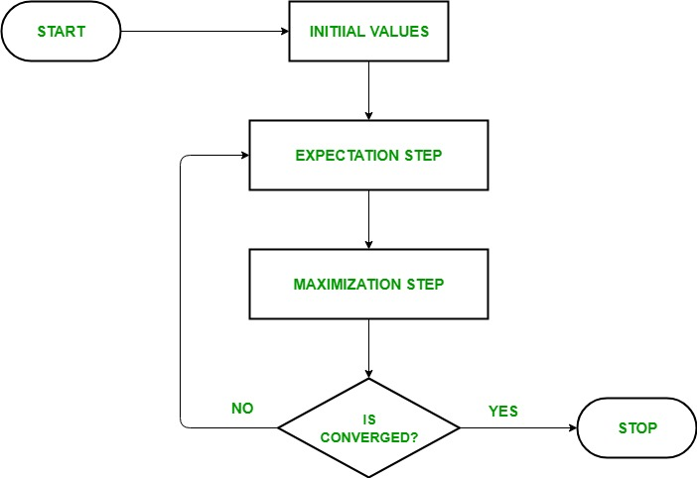
www.tuf.edu.pk
unioffaisalabad

Slide 12
www.tuf.edu.pk
unioffaisalabad
Advantages
Improved accuracy: Leveraging unlabeled data can improve model performance.
Robustness to labeling noise: EM can handle noisy or incomplete labels.
Challenges and Limitations
Assumptions: EM assumes the data is missing at random, which may not always hold.
Convergence: EM may converge to local optima or require careful initialization.
Computational complexity: EM can be computationally expensive for large datasets.

Slide 13
www.tuf.edu.pk
unioffaisalabad
Applications
Image classification: SSL with EM can improve image classification accuracy when labeled data is scarce.
Natural Language Processing (NLP): SSL with EM can be applied to text classification, sentiment analysis, and language modeling tasks.
Speech recognition: SSL with EM can improve speech recognition systems when labeled data is limited.

Slide 14
www.tuf.edu.pk
unioffaisalabad
Real-World Examples
Google's image recognition: Uses SSL with EM to improve image classification accuracy.
Stanford Natural Language Processing Group: Applies SSL with EM to various NLP tasks.

Slide 15
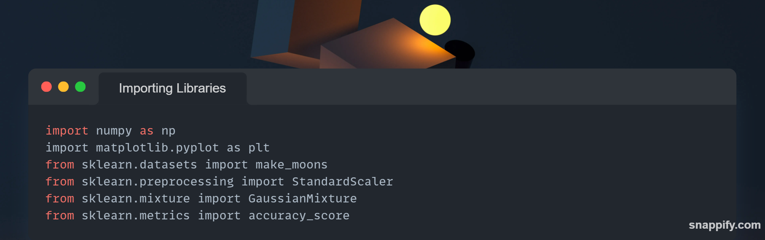
www.tuf.edu.pk
unioffaisalabad

Slide 16
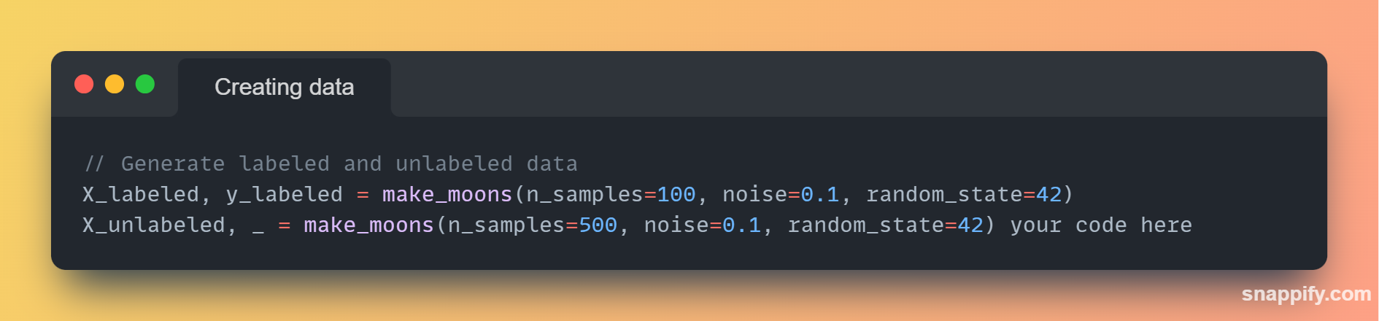
www.tuf.edu.pk
unioffaisalabad

Slide 17
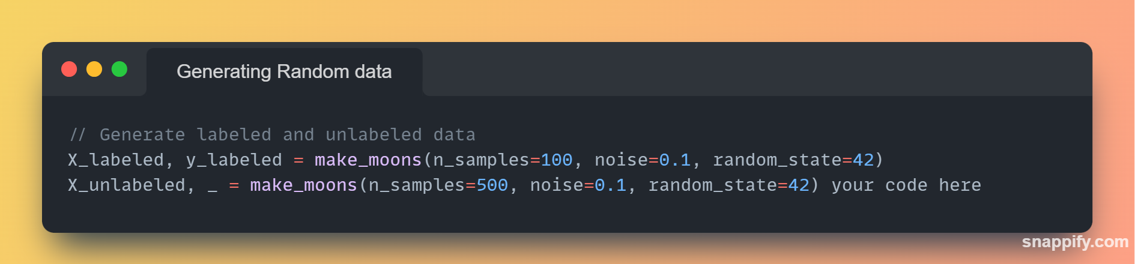
www.tuf.edu.pk
unioffaisalabad

Slide 18
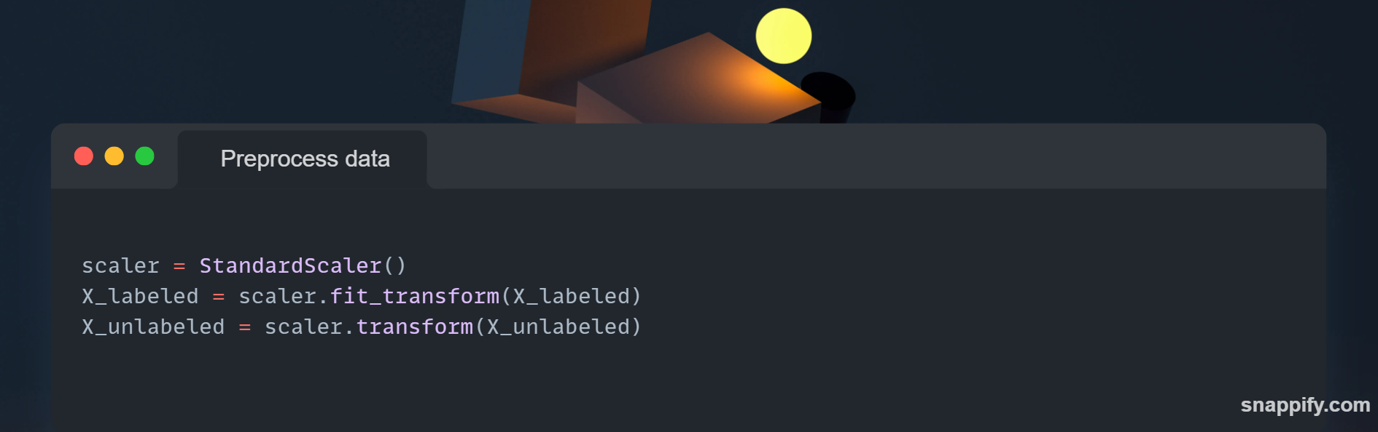
www.tuf.edu.pk
unioffaisalabad

Slide 19

www.tuf.edu.pk
unioffaisalabad

Slide 20
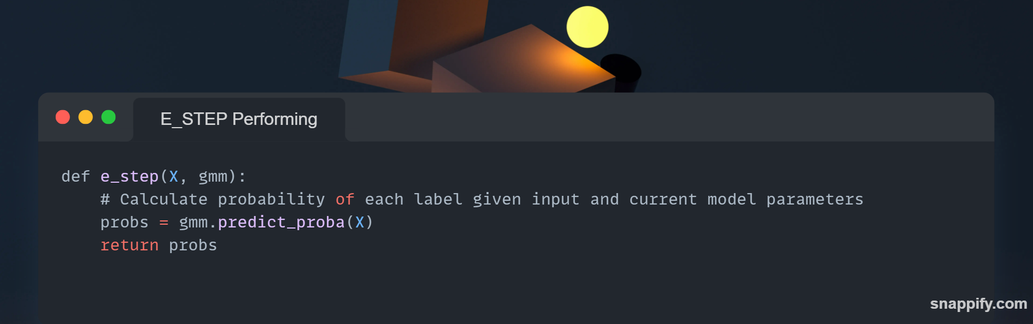
www.tuf.edu.pk
unioffaisalabad

Slide 21

www.tuf.edu.pk
unioffaisalabad

Slide 22
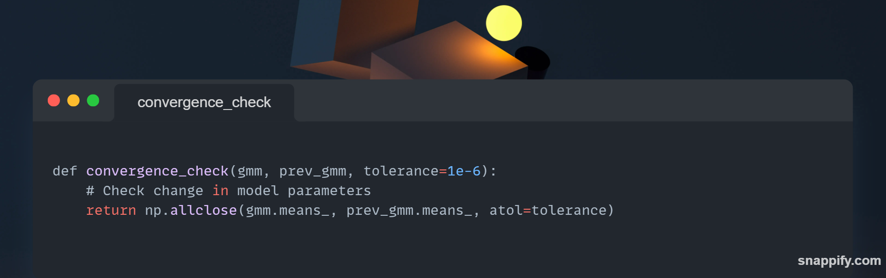
www.tuf.edu.pk
unioffaisalabad

Slide 23

www.tuf.edu.pk
unioffaisalabad

Slide 24
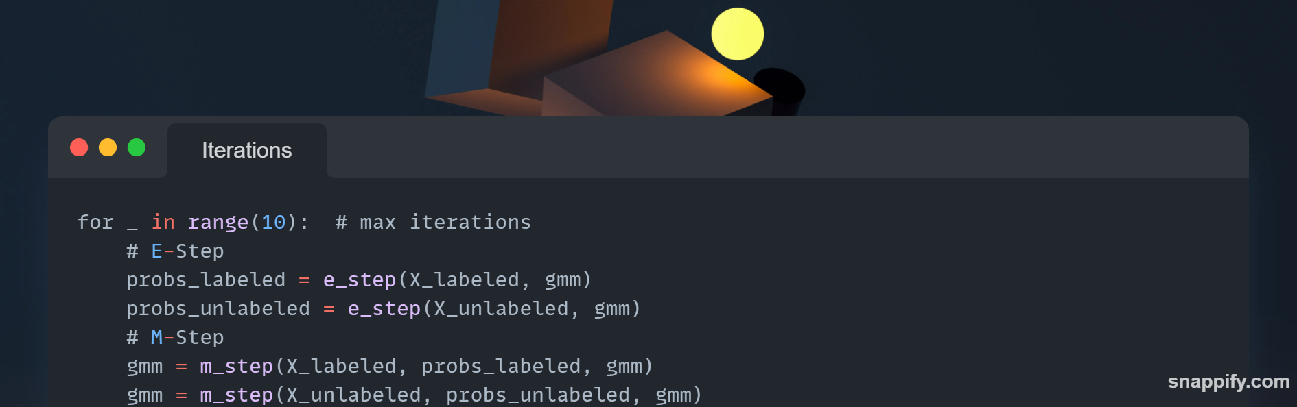
www.tuf.edu.pk
unioffaisalabad

Slide 25

www.tuf.edu.pk
unioffaisalabad

Slide 26
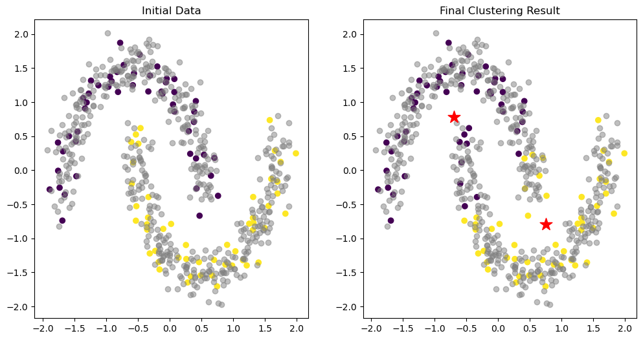
www.tuf.edu.pk
unioffaisalabad

Slide 27
www.tuf.edu.pk
unioffaisalabad
Further Reading: https://www.geeksforgeeks.org/ml-expectation-maximization-algorithm/

Slide 28
www.tuf.edu.pk
unioffaisalabad
Any Question ?

